Slide 1


Title: Library Database Analysis
Subtitle: An SQL Analysis Project
sanjay kommuju -- 479 batch

Slide 2
About me:
1.Background - B.tech in mechanical engineering
2. Why you want to learn Data Science
(actually my course is data analyst , transitioning into the IT and Data Analytics domain. Hands-on exposure to AWS Engineer Trainee role and currently undergoing Data Analytics because of i much interested in analytics and data-driven roles)
3. Any work experience
(experience as a AWS Engineer Trainee role in sonix IT solutins
Experience working with dashboards,EC2 , VPC, Policies , and automation, which built strong analytical and problem-solving
Passionate about turning raw data into clear insights and building dashboards for business decisions. )
4.Share your linkedin and github profile urls
linkedlin url -- www.linkedin.com/in/sanjay-kommuju-99ba24251
github url -- https://github.com/sanjayk2226

Slide 3
Agenda:
Objective of the Project :The objective of this project is to design and implement an Library Management System that efficiently stores and manages Library-related data
To design a structured relational database for library records
To manage books, borrowers, and library branches efficiently
To track book borrowing and returning transactions
To retrieve information using SQL queries for analysis and reporting
A Library Management System is a database-driven application designed to manage book records, user information, Authors info and borrowing transactions.
Traditional library management methods are manual and time-consuming, which may lead to data inconsistencies and inefficiencies

Slide 4
Problem Statement:
Many libraries still maintain records manually or in poorly structured systems. This leads to several challenges:
Difficulty tracking book availability
Time-consuming manual record maintenance
Risk of data duplication or loss
Inefficient search and reporting of books and borrowers
Therefore, a structured database system is required to manage library operations effectively

Slide 5
Tools Used:
SQL – Database creation and querying
DBMS Concepts – Data organization and relationships
Power Point & Dataset
Tables:
book
book_copies
book_authors
publisher
borrower
book_loans
library_branch

Slide 6
Tables and Dataset
Book[BookID, Title ,PublisherName]
Book_Copies
[CopiesID, BookID, BranchID ,No_Of_Copies]
Book_Authors
[AuthorID ,BookID, AuthorName]
Publisher[PublisherName,PublisherAddress,PublisherPhone]
Borrower
[CardNo,BorrowerName,BorrowerAddress,BorrowerPhone]
Book_loans
[LoansID ,BookID ,BranchID ,CardNo ,DateOut,DueDate]
Library_Branch[BranchID, BranchName , BranchAddress]

Slide 7
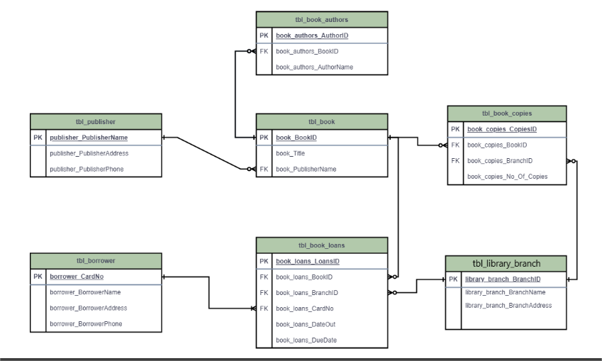
ER Diagram:
The ER Diagram represents the relationships between different entities in the library database as visually for better understanding

Slide 8
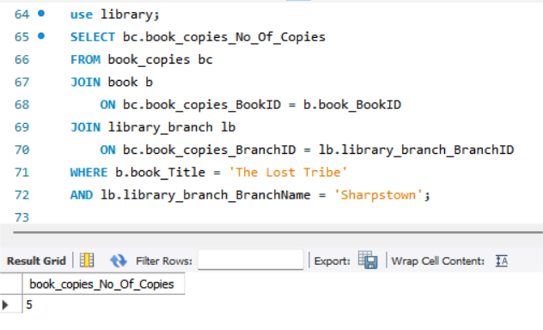
Key analysis questions (use cases):
Analysis b/w book , book_copies and library_branch:
1. How many copies of the book titled "The Lost Tribe" are owned by the library branch whose name is "Sharpstown"?
description:
• the query performs JOIN operations across three tables:
• Identified that 5 copies of the book "The Lost Tribe" are available in the Sharpstown branch

Slide 9
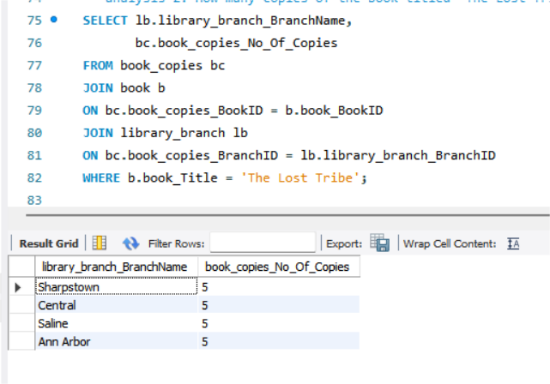
Analysis b/w book , book_copies and library_branch:
2. How many copies of the book titled "The Lost Tribe" are owned by each library branch?
description:
• Analyzed distribution of "The Lost Tribe" across branches and found that multiple branches maintain copies, with some branches holding up to 5+ copies
• ensuring balanced inventory allocation branch-wise inventory variation

Slide 10
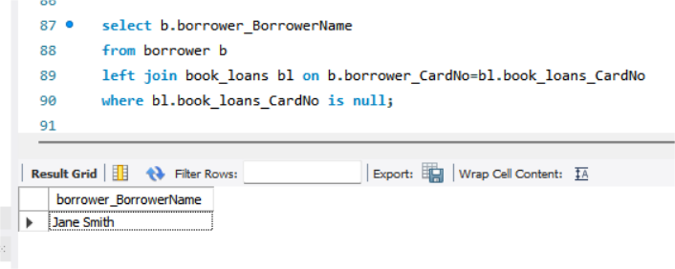
Analysis b/w book_loans and borrower:
3. Retrieve the names of all borrowers who do not have any books checked out
description:
• left table -- borrower & right table-- book_loans
• A LEFT JOIN is used to include all borrowers and match them with loan records
• Identified borrowers with zero active loans, indicating low user engagement or inactive members

Slide 11
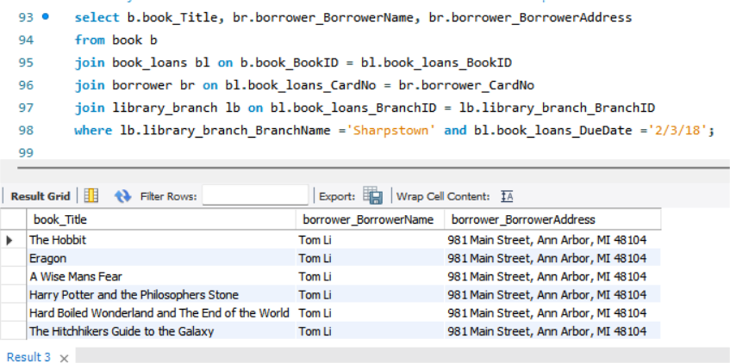
Analysis b/w book_loans,book and library_branch:
4.For each book that is loaned out from the "Sharpstown" branch and whose DueDate is 2/3/18, retrieve the book title, the borrower's name, and the borrower's address
description:
• Retrieved records of books Titles from Sharpstown branch with due date 02/03/2018, identifying active loan transactions
• Enabled tracking of borrower details and overdue risk for specific timeframes

Slide 12
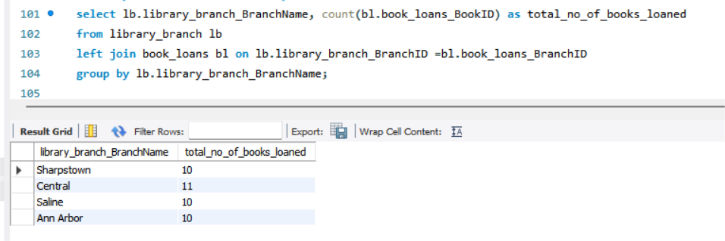
Analysis b/w library_branch and book_loans:
5. For each library branch, retrieve the branch name and the total number of books loaned out from that branch
description:
• left table --library_branch and right table-- book_loans
• Found that Central branch issued the highest number of books compared to other branches
• Central Branch = 11

Slide 13
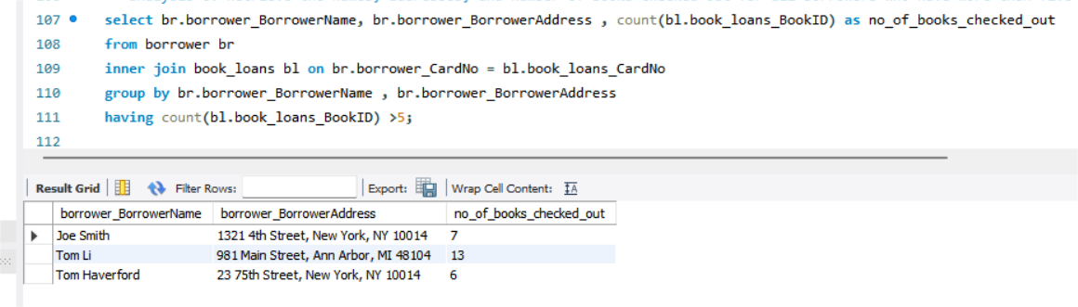
Analysis b/w borrower and book _loans:
6.Retrieve the names, addresses, and number of books checked out for all borrowers who have more than five books checked out
description:
• JOIN to connect the borrower table with the book_loans table using the borrower card number
• Identified borrowers who have issued more than 5 books, representing high-engagement users,These users contribute significantly to library circulation activity
• joe smith= 7 , Tom Li =13, Tom Haverford=6

Slide 14
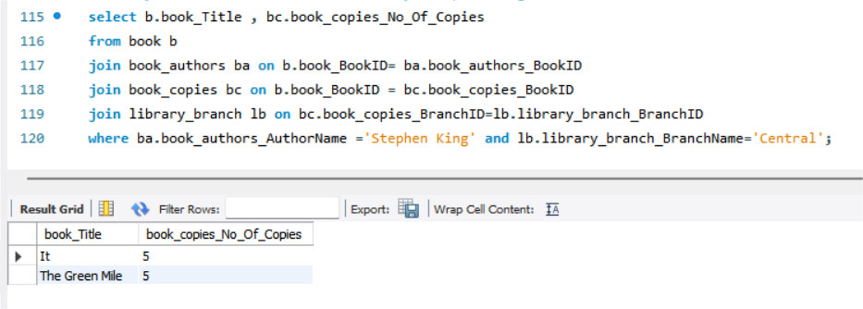
Analysis b/w book , book_author ,book_copies and library_branch:
7. For each book authored by "Stephen King", retrieve the title and the number of copies owned by the library branch whose name is "Central"
description:
• Found that Central branch holds copies of books authored by Stephen King, indicating strong availability of popular author content
• Helps in understanding author-wise demand and stock planning
• It =5 and The Green Mile =5

Slide 15
Conclusion (Key finding overall):
The Library Database Management System demonstrates how relational database design and SQL queries can effectively manage library records.
By structuring data into relational tables and using SQL for querying, the system enables efficient book tracking, borrower management, and information retrieval
Benefits of the DBMS in library database:
Efficient data storage and retrieval
Reduces manual errors
Faster book search and tracking
Better reporting and analysis
Improved library management

Slide 16
Your Experience/Challenges working:
experience :
to gain real time project experience
to learn how relational database design and SQL queries can effectively manage library records
handles the Efficient data storage and retrieval of library
instead of use of Traditional library management methods learned how DBMS helps libraries databases.
Challenges:
Defining correct table relationships and ensuring accurate use of foreign keys.
Maintaining data consistency with cascading updates and deletes.
Writing complex joins for Analysis
Preventing duplicate entries (values)

Slide 17


Slide 18

THANK YOU

